Slide 1
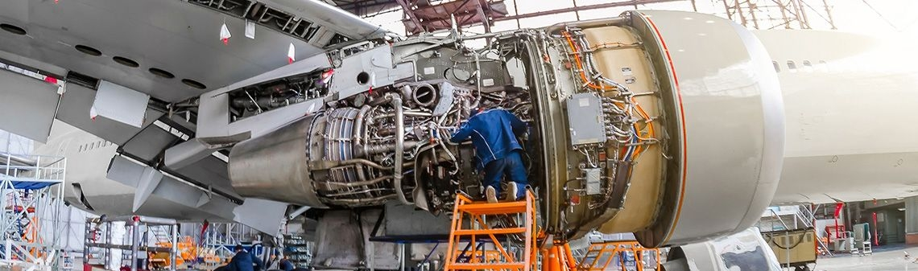
Predictive Maintenance w/ Machine Learning

Slide 2




The Team
Yuvaraj Raju
Arun Narayanan
Jose Araujo
Tony McAllister

Slide 3
The Objective
Build a machine learning model to predict the number of remaining operational cycles before failure in the test set, i.e., the number of operational cycles after the last cycle that the engine will continue to operate.
“Predictive” maintenance implies that maintenance is scheduled when a system predicts the possible occurrence of a failure even in the future. With Machine Learning (ML), it is possible to train models to detect abnormal patterns from sensor data. The trained ML model does not require rules or pre-programmed thresholds, and vast amounts of data can be analyzed repeatably with no need of human involvement.

Slide 4
The Data
DATASET
NASA provided turbofan engine simulation model C-MAPPS (or Commercial Modular Aero Propulsion System Simulation)
Fleet of engines
Time series data
3 operational settings
26 sensors

Slide 5
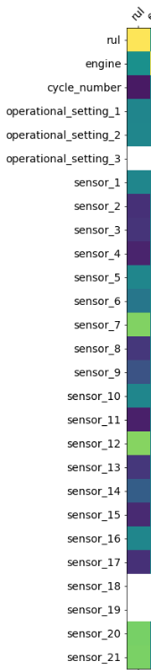
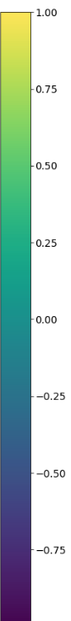
The Data
1
2
3
4
Data correlation of 4 training data sets. Hypothesis that some subset of sensor data will indicate that an engine failure is impending.
Presumably the operational settings influence sensor data and could be tuned to optimize engine uptime between maintenance events.

Slide 6
The Data
Training Set #3 Histograms – Sensors #1-12
1
2
3
4
5
6
7
8
9
10
11
12

Slide 7
The Data
Training Set #4 Histograms – Sensors #1-12
1
2
3
4
5
6
7
8
9
10
11
12

Slide 8
ETL StRategy
Group time-series data by engine
Cleanup empty data
Calculate remaining useful life for each engine
Remove data interpreted to be unnecessary
Hot Encode on engine #
Split into training and validation data sets

Slide 9
modeling Stategy

